Slide 1
Awkward Triangle

Slide 2
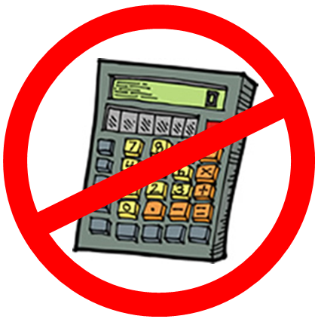



Awkward Triangle
(not to scale)
What’s the exact area of this triangle?
$$\sqrt{3}$$
$$\frac{2\sqrt{6}}{3}$$
$$\frac{\sqrt{15}}{3}$$

Slide 3
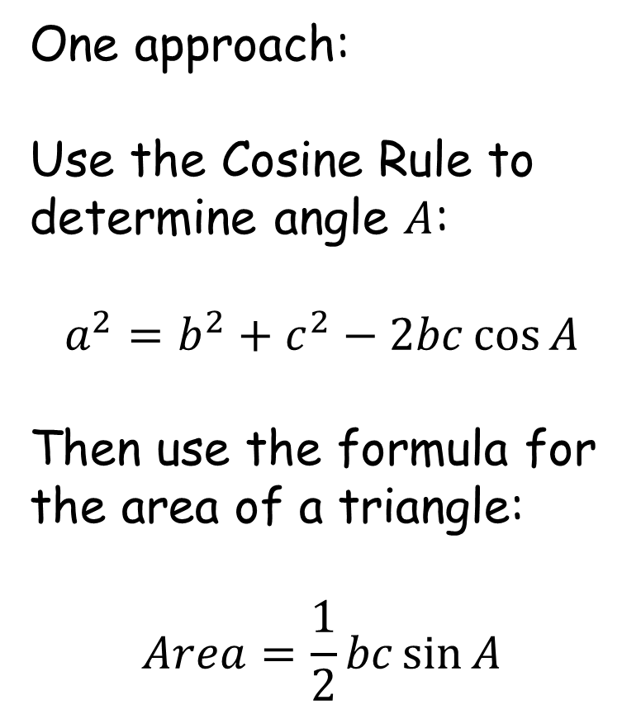

Awkward Triangle
(not to scale)
One approach:
Use the Cosine Rule to determine angle $A$:
$$a^{2}=b^{2}+c^{2}−2bc\cos{A}$$
Then use the formula for the area of a triangle:
$$Area=\frac{1}{2}bc\sin{A}$$
$$\sqrt{3}$$
$$\frac{2\sqrt{6}}{3}$$
$$A$$
$$\frac{\sqrt{15}}{3}$$

Slide 4

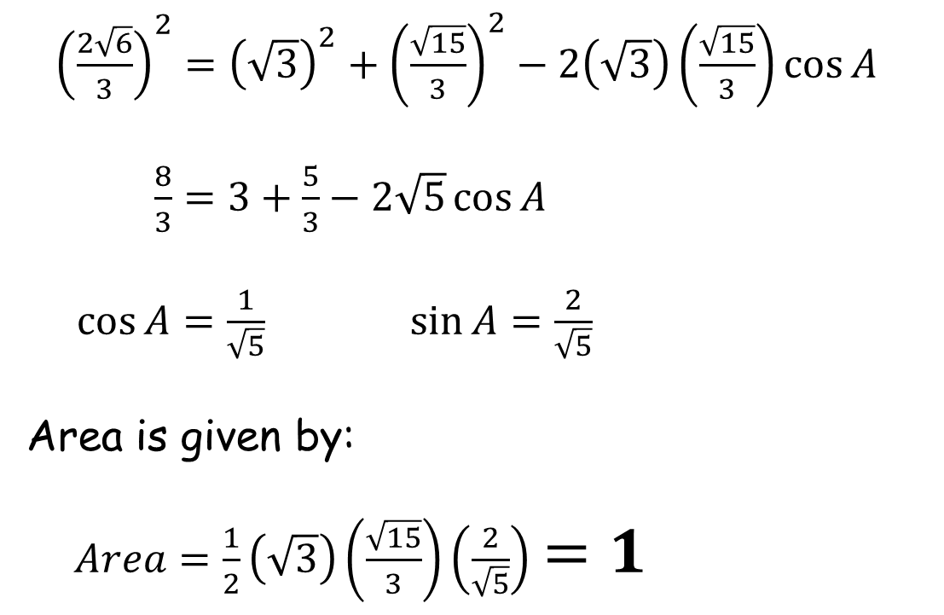







Awkward Triangle
${\left(\frac{2\sqrt{6}}{3}\right)}^{2}={\left(\sqrt{3}\right)}^{2}+{\left(\frac{\sqrt{15}}{3}\right)}^{2}−2\left(\sqrt{3}\right)\left(\frac{\sqrt{15}}{3}\right)\cos{A}$
$\frac{8}{3}=3+\frac{5}{3}−2\sqrt{5}\cos{A}$
$\cos{A}=\frac{1}{\sqrt{5}}$ $\sin{A}=\frac{2}{\sqrt{5}}$
Area is given by:
$Area=\frac{1}{2}\left(\sqrt{3}\right)\left(\frac{\sqrt{15}}{3}\right)\left(\frac{2}{\sqrt{5}}\right)$ $=1$
$$\sqrt{3}$$
$$\frac{2\sqrt{6}}{3}$$
$$A$$
$$\frac{\sqrt{15}}{3}$$
$$\sqrt{5}$$
$$2$$
$$A$$
$$1$$

Slide 6
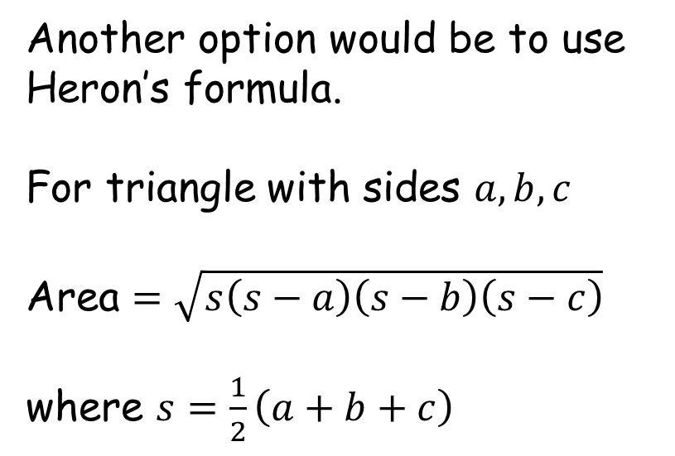
Awkward Triangle
(not to scale)
Another option would be to use Heron’s formula.
For triangle with sides $a,b,c$
Area $=\sqrt{s\left(s−a\right)\left(s−b\right)\left(s−c\right)}$
where $s=\frac{1}{2}\left(a+b+c\right)$
$$\sqrt{3}$$
$$\frac{2\sqrt{6}}{3}$$
$$\frac{\sqrt{15}}{3}$$

Slide 7
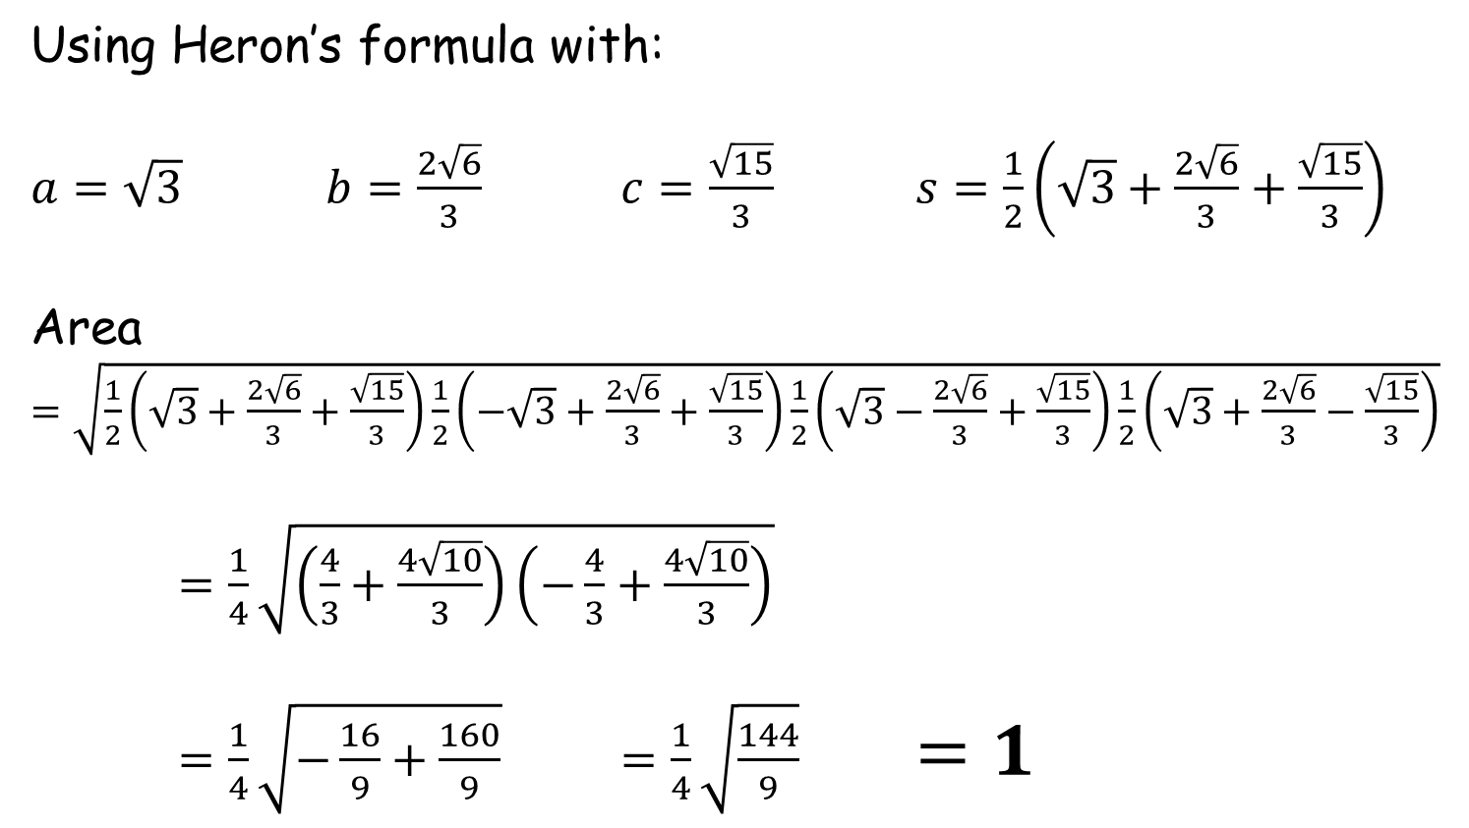
Awkward Triangle
Using Heron’s formula with:
$a=\sqrt{3}$ $b=\frac{2\sqrt{6}}{3}$ $c=\frac{\sqrt{15}}{3}$ $s=\frac{1}{2}\left(\sqrt{3}+\frac{2\sqrt{6}}{3}+\frac{\sqrt{15}}{3}\right)$
Area $=\sqrt{\frac{1}{2}\left(\sqrt{3}+\frac{2\sqrt{6}}{3}+\frac{\sqrt{15}}{3}\right)\frac{1}{2}\left(−\sqrt{3}+\frac{2\sqrt{6}}{3}+\frac{\sqrt{15}}{3}\right)\frac{1}{2}\left(\sqrt{3}−\frac{2\sqrt{6}}{3}+\frac{\sqrt{15}}{3}\right)\frac{1}{2}\left(\sqrt{3}+\frac{2\sqrt{6}}{3}−\frac{\sqrt{15}}{3}\right)}$
$=\frac{1}{4}\sqrt{\left(\frac{4}{3}+\frac{4\sqrt{10}}{3}\right)\left(−\frac{4}{3}+\frac{4\sqrt{10}}{3}\right)}$
$=\frac{1}{4}\sqrt{−\frac{16}{9}+\frac{160}{9}}$ $=\frac{1}{4}\sqrt{\frac{144}{9}}$ $=1$

Slide 8

Awkward Triangle
(not to scale)
What’s the exact area of this triangle?
$$\sqrt{3}$$
$$\frac{2\sqrt{6}}{3}$$
$$1$$
$$\frac{\sqrt{15}}{3}$$

Slide 10
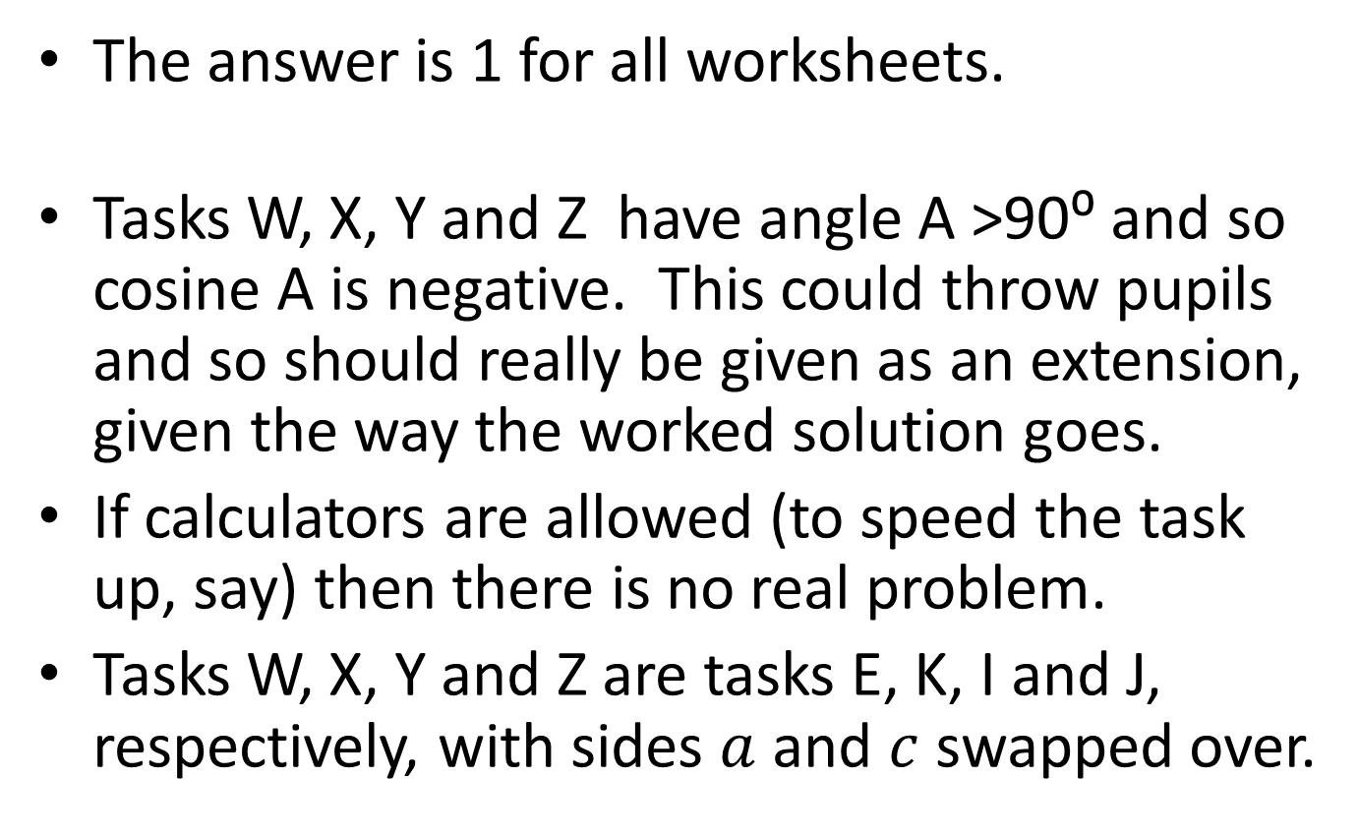
Note to Teacher
The answer is 1 for all worksheets.
Tasks W, X, Y and Z have angle A >90⁰ and so cosine A is negative. This could throw pupils and so should really be given as an extension, given the way the worked solution goes.
If calculators are allowed (to speed the task up, say) then there is no real problem.
Tasks W, X, Y and Z are tasks E, K, I and J, respectively, with sides $a$ and $c$ swapped over.

Slide 11
RESOURCES

Slide 12
Awkward Triangle
(not to scale)
What’s the exact area of this triangle?
$$\sqrt{3}$$
$$\frac{2\sqrt{6}}{3}$$
$$\frac{\sqrt{15}}{3}$$
SIC_38

Slide 13


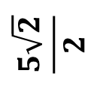



A
B
(not to scale)
(not to scale)
$$\frac{\sqrt{2}}{2}$$
$$1$$
$$2\sqrt{2}$$
$$4$$
$$\sqrt{5}$$
$$\frac{5\sqrt{2}}{2}$$
Awkward Triangle
Awkward Triangle
What’s the exact area of this triangle?
What’s the exact area of this triangle?
SIC_38
SIC_38

Slide 14
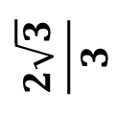

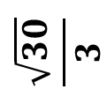

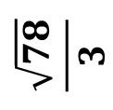

C
D
(not to scale)
$$\frac{\sqrt{6}}{3}$$
(not to scale)
$$\frac{2\sqrt{3}}{3}$$
$$2\sqrt{3}$$
$$\sqrt{6}$$
$$\frac{\sqrt{78}}{3}$$
$$\frac{\sqrt{30}}{3}$$
Awkward Triangle
Awkward Triangle
What’s the exact area of this triangle?
What’s the exact area of this triangle?
SIC_38
SIC_38

Slide 15
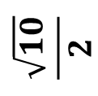

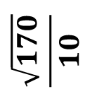
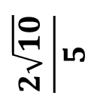
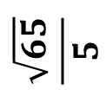
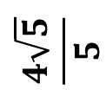
E
F
(not to scale)
$$\frac{2\sqrt{10}}{5}$$
(not to scale)
$$\frac{\sqrt{10}}{2}$$
$$\sqrt{5}$$
$$\frac{4\sqrt{5}}{5}$$
$$\frac{\sqrt{65}}{5}$$
$$\frac{\sqrt{170}}{10}$$
Awkward Triangle
Awkward Triangle
What’s the exact area of this triangle?
What’s the exact area of this triangle?
SIC_38
SIC_38

Slide 16




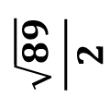
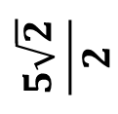
G
H
(not to scale)
(not to scale)
$$\frac{\sqrt{2}}{2}$$
$$\frac{1}{2}$$
$$\frac{5\sqrt{2}}{2}$$
$$5$$
$$\frac{\sqrt{89}}{2}$$
$$\sqrt{10}$$
Awkward Triangle
Awkward Triangle
What’s the exact area of this triangle?
What’s the exact area of this triangle?
SIC_38
SIC_38

Slide 17


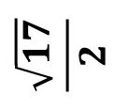
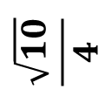
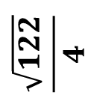

I
J
(not to scale)
$$\frac{\sqrt{10}}{4}$$
(not to scale)
$$1$$
$$\sqrt{10}$$
$$\frac{5}{2}$$
$$\frac{\sqrt{122}}{4}$$
$$\frac{\sqrt{17}}{2}$$
Awkward Triangle
Awkward Triangle
What’s the exact area of this triangle?
What’s the exact area of this triangle?
SIC_38
SIC_38

Slide 18


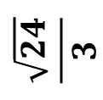

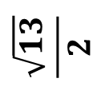
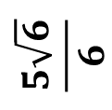
K
L
(not to scale)
$$\frac{\sqrt{5}}{2}$$
(not to scale)
$$\frac{\sqrt{6}}{2}$$
$$\frac{5\sqrt{6}}{6}$$
$$\sqrt{5}$$
$$\frac{\sqrt{13}}{2}$$
$$\frac{\sqrt{24}}{3}$$
Awkward Triangle
Awkward Triangle
What’s the exact area of this triangle?
What’s the exact area of this triangle?
SIC_38
SIC_38

Slide 19




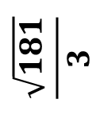
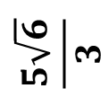
M
N
(not to scale)
(not to scale)
$$\frac{\sqrt{6}}{3}$$
$$\frac{2}{3}$$
$$\frac{5\sqrt{6}}{3}$$
$$5$$
$$\frac{\sqrt{181}}{3}$$
$$\sqrt{12}$$
Awkward Triangle
Awkward Triangle
What’s the exact area of this triangle?
What’s the exact area of this triangle?
SIC_38
SIC_38

Slide 20

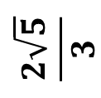
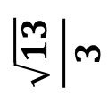

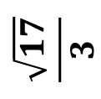

O
P
(not to scale)
$$\frac{2\sqrt{5}}{3}$$
(not to scale)
$$2$$
$$\sqrt{5}$$
$$\frac{5}{3}$$
$$\frac{\sqrt{17}}{3}$$
$$\frac{\sqrt{13}}{3}$$
Awkward Triangle
Awkward Triangle
What’s the exact area of this triangle?
What’s the exact area of this triangle?
SIC_38
SIC_38

Slide 21

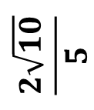


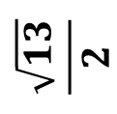
W
X
(not to scale)
(not to scale)
$$\sqrt{5}$$
$$\sqrt{5}$$
$$\frac{2\sqrt{10}}{5}$$
$$\frac{\sqrt{5}}{2}$$
$$\frac{\sqrt{65}}{5}$$
$$\frac{\sqrt{13}}{2}$$
Awkward Triangle
Awkward Triangle
What’s the exact area of this triangle?
What’s the exact area of this triangle?
SIC_38
SIC_38

Slide 22


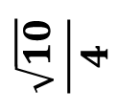

Y
Z
(not to scale)
(not to scale)
$$\sqrt{10}$$
$$\frac{5}{2}$$
$$\frac{\sqrt{10}}{4}$$
$$1$$
$$\frac{\sqrt{122}}{4}$$
$$\frac{\sqrt{17}}{2}$$
Awkward Triangle
Awkward Triangle
What’s the exact area of this triangle?
What’s the exact area of this triangle?
SIC_38
SIC_38

Slide 23
REFERENCE MATERIAL

